Slide 1
Chapter 3.1 High-Quality Variables
CCSW 325 (Software Construction)
Notes:
Last Update: 22/8/2019
Version 1.0

Slide 2
Outline
Variables initialization problems
Guidelines for avoiding initialization problems

Slide 3
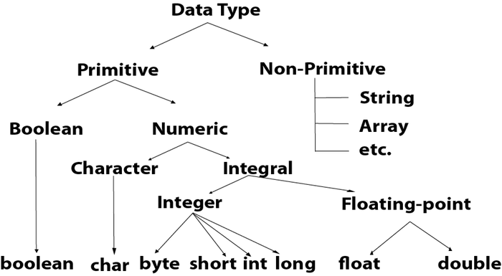
Variables Initialization problems
The first step in creating effective data is knowing which kind of data to create.

Slide 4
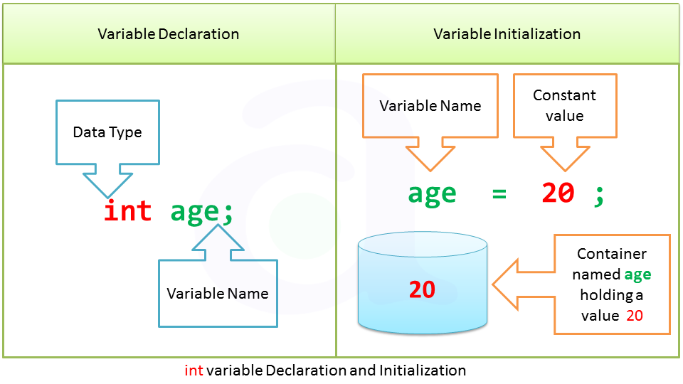
Variables initialization problems
Improper data initialization is one of the most fertile sources of error in computer programming.

Slide 5

Variables initialization problems
The problem with improper initialization stem from a variable’s containing an initial value that you do not expect it to contain.

Slide 6
Variables initialization problems
This can happen for any of several reasons:
The variable has never been assigned a value. Its value is whatever bits happened to be in its area of memory when the program started
The value of the variable is outdated. The variable was assigned a value at some point, but the value is no longer valid
Part of the variable has been assigned a value and part has not. That can happen when you initialize some of the members of an object but not all of them

Slide 7

Guidelines for avoiding initialization problems
Developing effective techniques for avoiding initialization problems can save a lot of debugging time.

Slide 8

Guidelines for avoiding initialization problems
Initialize each variable as it’s declared
Initializing variables as they’re declared is an inexpensive form of defensive programming.
It’s a good insurance policy against initialization errors.

Slide 9
Guidelines for avoiding initialization problems
Initialize each variable close to where it’s first used
Some languages, including Visual Basic, don’t support initializing variables as they’re declared.
That can lead to coding styles, in which declarations are grouped together, and then initializations are grouped together—all far from the first actual use of the variables.

Slide 10
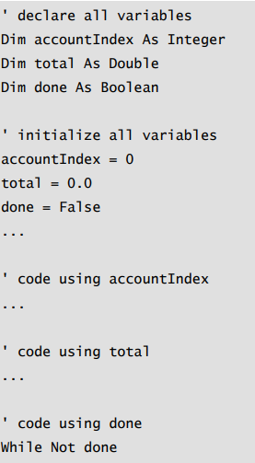
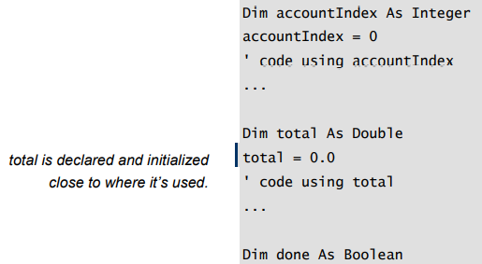
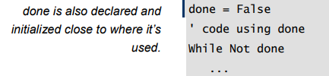
Guidelines for avoiding initialization problems
A better practice is to initialize variables as close as possible to where they’re first used
Visual Basic Example of Bad Initialization
Visual Basic Example of Good Initialization

Slide 11
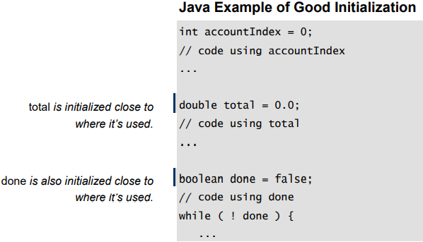
Guidelines for avoiding initialization problems
Declare and define each variable close to where it’s used

Slide 12
Guidelines for avoiding initialization problems
Pay special attention to counters and accumulators
The variables i, j, k, sum, and total are often counters or accumulators.
A common error is forgetting to reset a counter or an accumulator before the next time it’s used.

Slide 13
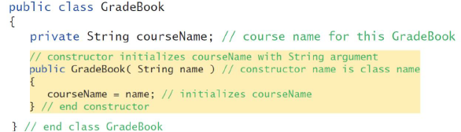
Guidelines for avoiding initialization problems
Initialize a class’s member data in its constructor
Just as a routine’s variables should be initialized within each routine, a class’s data should be initialized within its constructor.
If memory is allocated in the constructor, it should be freed in the destructor.

Slide 14
Guidelines for avoiding initialization problems
Check the need for reinitialization
If the variable needs to be reinitialized—either because a loop in the routine uses the variable many times or because the variable retains its value between calls to the routine and needs to be reset between calls. If it needs to be reinitialized, make sure that the initialization statement is inside the part of the code that’s repeated.
Notes:
for i in range(5):
sum = 0 # reinitializing sum for each iteration # ... some operations that modify sum ..

Slide 15
Guidelines for avoiding initialization problems
Use the compiler setting that automatically initializes all variables
Take advantage of your compiler’s warning messages
Check input parameters for validity
Use a memory-access checker to check for bad pointers
Initialize working memory at the beginning of your program
Notes:
Use the Compiler Setting that Automatically Initializes All Variables:
Many modern compilers offer settings or flags that automatically initialize variables to default values. This can prevent unintended behavior from uninitialized variables.
For example, in some C/C++ compilers, you can use flags like -Wall to enable all warnings, which might include warnings about uninitialized variables.
Take Advantage of Your Compiler’s Warning Messages:
Compiler warnings provide valuable feedback about potential issues in your code. While these issues might not always lead to errors, they can indicate bad practices or potential pitfalls.
Always aim to compile code with zero warnings. Treat warnings as potential errors.
Check Input Parameters for Validity:
Before processing input parameters in a function or method, validate them. Ensure they are within expected ranges or formats.
This can prevent unexpected behavior, especially when dealing with external inputs that you don't have control over.
Use a Memory-Access Checker to Check for Bad Pointers:
Tools like Valgrind (for C/C++) can help detect memory leaks, invalid memory access, and other memory-related issues.
These tools are invaluable for languages that allow direct memory manipulation, as they can catch issues that are often hard to diagnose.
Initialize Working Memory at the Beginning of Your Program:
Before using any memory (like arrays or buffers), initialize it to a known state. This can prevent issues arising from stale or garbage values.
For instance, in C/C++, you can use functions like memset to set all bytes of a block of memory to a specific value.

Slide 16
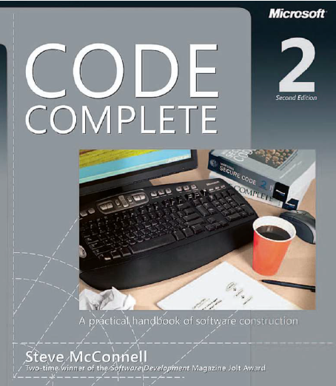
Reading
Code Complete: A Practical Handbook of Software Construction, 2nd Edition, Steve McConnell.
Chapter 10

Slide 17

Any questions? ​
Please feel free to raise your hands and ask.

